Slide 1
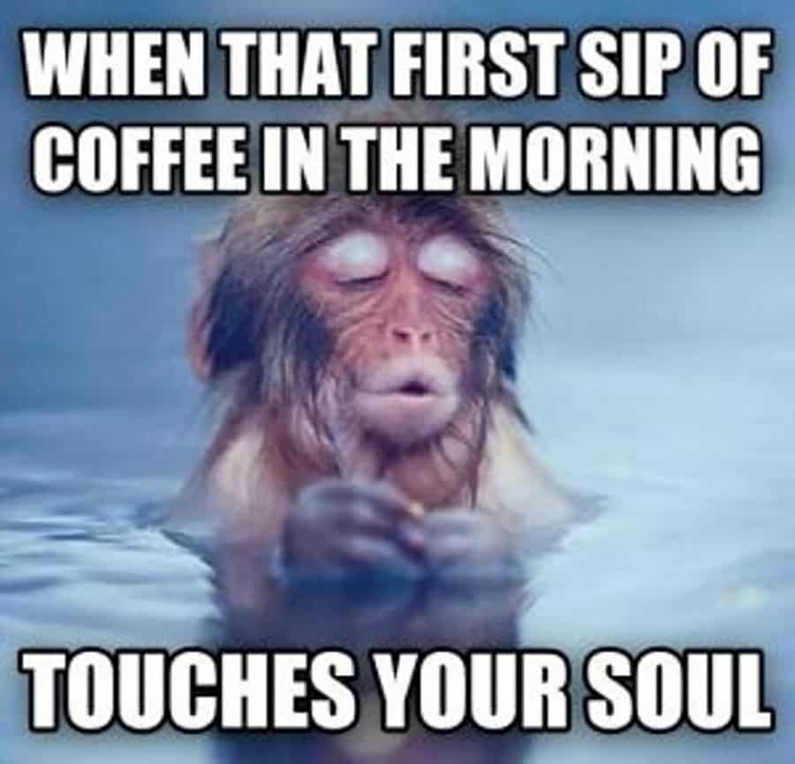
Good Morning

Slide 2




Research Design

Slide 3
Recap
Exploratory Research
Literature search
Depth Interviews
Focus Group
Case Discussion #1

Slide 4

iClicker Question
Who should you ask when conducting in-depth interview (exploratory research) for a marketing problem?
Those who work it (e.g., employees)
Those who study it (e.g., researchers)
Those who live it (e.g., consumers)
A and B only
A, B, and C

Slide 5
iClicker Question
Why at 1 and 2 connection per node (i.e., an individual has 1 or 2 friends) we saw no changes in the time it takes to reach the whole population, but in 3 connections per node, we can see abrupt changes in the time it takes?
Bottleneck effect
Founder effect
Threshold effect
Notes:
Bonus question

Slide 6
iClicker Question
What is the pitfall of focus group?
Managers expect to deliver final results
Managers want to see what they expect (confirmation bias)
Both A and B

Slide 7

Learning Objectives
Other explanatory research methods
Data Mining
Case Analyses
Ethnography
Project Method
Discuss PA #3

Slide 8
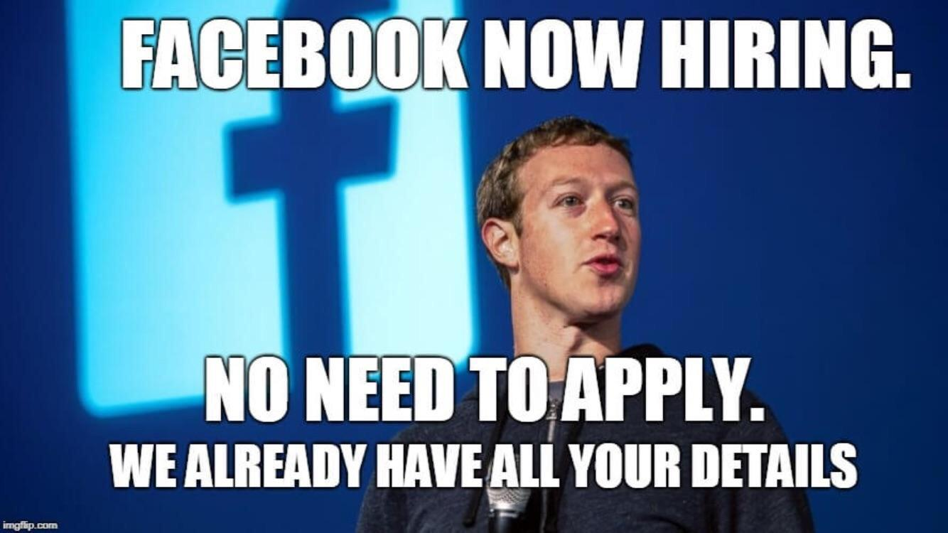
Data Mining
The use of powerful analytic technologies to quickly and thoroughly explore mountains of data to obtain useful information
Although most forms of exploratory research are qualitative in nature, data mining involves sophisticated quantitative analysis of data held in a company’s databases
Notes:
1-800-flowers.com used data mining to develop successful promotions after discovering that professional, suburban moms were a key demographic for them.

Slide 9

Case Analyses
Intensive study of selected examples of the phenomenon of interest, especially in cases where
Recent change
Extreme behaviors
The “best” and “worst” situation
Notes:
Especially effective with cases reflecting
Recent change
Extremes of behavior
The “best” and “worst” situations
Examples: hertz, dollar shave club

Slide 10
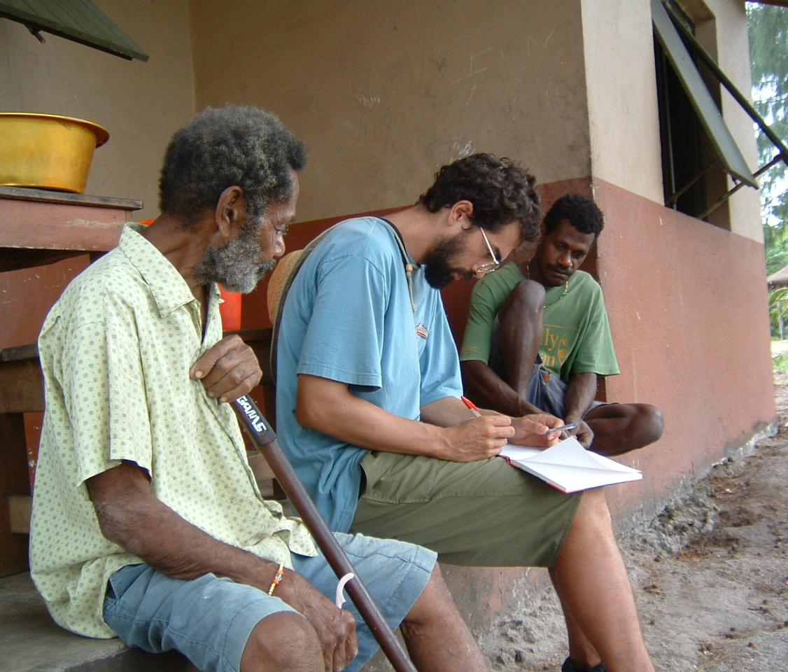
Ethnography
The detailed observation of consumers during their ordinary daily lives using direct observations, interviews, and video and audio recordings
This Photo by Unknown Author is licensed under CC BY
Notes:
Basically, you live with consumers in their households. Companies like Unilever, Tesco and LEGO use this method a lot

Slide 11
Benchmarking
Using organizations that excel at some functions as sources of ideas for improvement.

Slide 12
Projective Methods
Methods that encourage respondents to reveal their own feelings, thoughts, and behaviors by shifting the focus away from the individual through use of indirect tasks.
Word association
Sentence completion
Storytelling
Role Playing
Notes:
For example, when I say Nike, what words first come to you?
People could use this method to study hard subjects like STD studies, or racisms.
As you can see, there is tradeoffs between depth and breadth from in-depth interview, ethnography, case analyses to focus group to data mining.

Slide 13
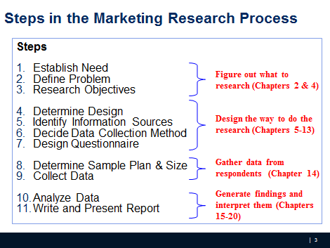
Where we are
Notes:
We are at the end of chapter 4. and now we are getting to chapter 5.

Slide 14
Research Design
Research design is a set of advance decisions that make up the master plan specifying methods and procedures for collecting and analyzing the needed information
Notes:
Now we go into detail of research design

Slide 15
Types of Research Design
The choice of the most appropriate design depends largely on the objectives of the research and how much is known about the problem
Notes:
We select types of research design based on our objectives of the research

Slide 16
Types of Research Design
Three traditional categories/methods:
Exploratory
Descriptive
Causal
Notes:
We have three types of research design; I think we should get the gist exploratory research method by now.
And we will get to know descriptive and causal research later.
When we did text mining in the first session, what would you call it?

Slide 17
Research Objective vs. Appropriate Design
Research Objective | Appropriate Design
To gain background information, to define terms, to clarify problems and hypothesis, to establish research priorities | Exploratory
To describe and measure marketing phenomena at a point in time | Descriptive
To determine causality, to make “if-then” statements | Causal
Notes:
Here is a reference table for you to choose which design best fits your research objective.
So, to gain background info

Slide 18
Exploratory Research
Exploratory research is most commonly unstructured, informal research that is undertaken to gain background information about the general nature of the research problem
By unstructured, we mean there is no formal set of objectives, sample plan, or questionnaire.
Notes:
As we notice, exploratory research typically is unstructured, and informal, there is no set of procedures, objectives, sample plan, or questionnaire.

Slide 19
iClicker Question
Data mining should not be under exploratory research because it uses structured data, while exploratory research definition means unstructured research. Do you agree with this statement?
Agree
Disagree
Notes:
Even though in data mining, we have structure data, it has a different meaning from the word unstructured we use here
Structure data means data are in table or relational format
Unstructured data means data that are not in table format (i.e., picture, text, etc.)

Slide 20
Exploratory Research (Qualitative Research)
Goal: generate ideas (e.g., what, why) for descriptive and exploratory research (quantitative research)
Uses:
Gain Background information
What is a bank image study?
Define Terms
What terms are used?
Clarify problems and hypothesis
What type of bank customers? Retail? Commercial? Correspondent banks?
Establish Research Priories
Notes:
Just a reminder, the goal of exploratory research is to:
RQ: What criteria do households use when selecting department stores. Why do they do so?
See the talking points with the client
Many questions; many sources
Defining the problem; getting a “feel”

Slide 21
Research Design: Exploratory Research
A variety of methods are available to conduct exploratory research
Ethnography: Living the experience, observation without interference
Case Analysis
Focus Groups: Talk to people to get their opinion
Secondary data analysis
Others (Depth Interview, protocol analysis, projective techniques)

Slide 22
Descriptive Research
Descriptive research is undertaken to describe answers to questions of who, what, where, when.
Descriptive research is desirable when we wish to project a study’s findings to a larger population, if the study’s sample is representative
Notes:
Then we have the definition of descriptive research is: to describe answers to questions of who, etc.

Slide 23
Descriptive Research
Goal: quantify the responses (e.g., how much? What percent?)
Uses
Measure performance
How is the bank doing in terms of customer satisfaction?
Notes:
Assess market-related phenomena
Why do people prefer brand X over Y
Example: questionnaire/ survey

Slide 24
Research Design: Descriptive Research
Cross-sectional: measure units from a sample of the population at only one point in time. E.g., Survey
Longitudinal: repeatedly measure the sample over time. E.g., Panels (continuous vs. discontinuous)
Notes:
In descriptive research, there are two basic classifications:
Cross-sectional: measure units from a sample of the population at only one point in time. E.g., Survey
Longitudinal: repeatedly measure the sample over time. E.g., Panels (continuous vs. discontinuous)

Slide 25
Marketing Research Panels
Continuous panels ask panel members the same questions on each panel measurement. Uses – Brand tracking studies, measure change in consumer attitude, behavior etc.
Discontinuous panels (also known as Omnibus) vary questions from one panel measurement to the next. Uses – provide a very broad sample
Notes:
Regarding marketing research panels, continuous panels ask …

Slide 26
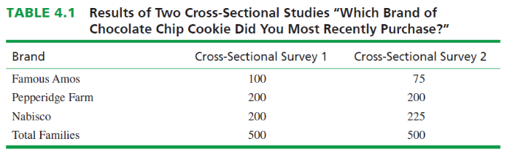
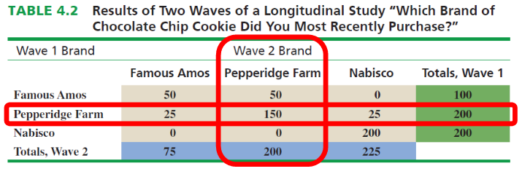
Marketing Research Panels - does Pepperidge Farm need to worry about its competitors?

Slide 27

Causal Research
Causality may be thought of as understanding a phenomenon in terms of conditional statements of the form “If x, then y.”
Causal studies are (mostly) conducted through the use of experiments
Notes:
Next, we have causal research
Why I say mostly here.
Because experiment is the gold standard of causal research, sometimes with extremely sophisticated statistical method, you might be able to get causal inference, which is a branch of statistics as well.

Slide 28

Other Quasi-experimental Designs
For reference, check my book
Regression Discontinuity
Difference-in-differences
Synthetic Control
Event studies
Matching Methods
Interrupted Times series

Slide 29
Research Design: Causal Research
An experiment is defined as manipulating an independent variable to see how it affects a dependent variable, while also controlling the effects of additional extraneous variables.
Two Types of Experiments
Laboratory Experiment
Field Experiment
Notes:
Why we say experiment is the gold standard of causal inference. We first need to understand the definition of experiment.
An experiment is …
Lab is easy
Field experiment is hard
Why do you think I say lab is easy and field experiment is hard?
Control environment versus a lot of uncontrolled variables in the real-world.

Slide 30
Independent Variable
Independent variables are those variables which the researcher has control over and wishes to manipulate. (E.g., level of ad expenditure; type of ad appeal; price; product features, etc.)
Notes:
Look at previous correlation slide

Slide 31
Dependent Variable
Dependent variables are those variables that we have little or no direct control over, yet we have a strong interest in. E.g., return on investment (ROI), net profits, market share, customer satisfaction.

Slide 32
Extraneous Variables
Extraneous variables (control variables) are those
variables that may have some effect on a dependent
variable yet are not independent variables.
Extraneous variables must be controlled through proper experimental design.

Slide 33

Experiment
Scientific investigation in which an investigator manipulates one or more independent variables and observes the degree to which the dependent variables change
The basic point of an experiment is to change the levels of one or more X variables and examine the resulting impact on Y while at the same time controlling (holding constant) other variables that might impact Y
Lab experiment: Research investigation in which investigators create a situation with exact conditions to control some variables and manipulate others
Field experiment: research study in a realistic situation in which one or more independent variables are manipulated by the experimenter under as carefully controlled conditions as the situation will permit.

Slide 34
Experimental Design
Experimental design is a procedure for devising an experimental setting such that a change in a dependent variable may be attributed solely to the change in an independent variable.
Notes:
We are not going to go in depth about experimental design.
There is a class dedicated to teaching experimental design if you want to take it.
But I will briefly mention it here
So experimental design is …

Slide 35
Causal Research
Uses
To find causes
What makes movies like “The Dark Knight Rises” appeal to masses
Does background music affect purchase behavior?

Slide 36
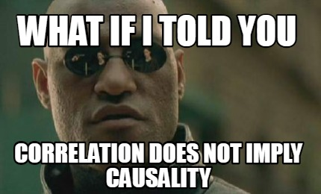
Conditions for Causality
Correlation
Notes:
So how can we establish causality?
What is Correlation?
The degree to which two variables move in relation to each other
Or how two variables move in relation to one another
Correlation does not mean causation

Slide 37
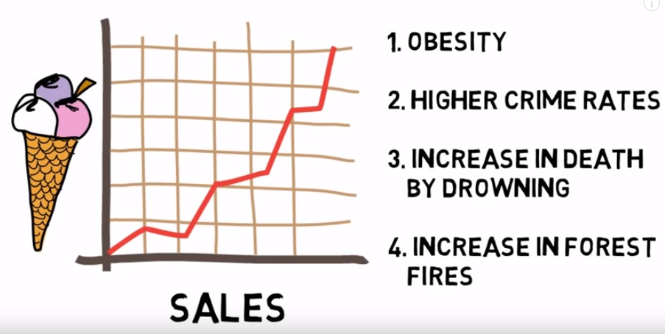
Causality – or is it really?
Notes:
Spurious Correlation

Slide 38
Correlation ≠ Causation
A
B
A
B
1
4
2
A
B
C
5
3
A
B
A
B
Notes:
To understand why we cannot establish causality with the first condition, (correlation), we will try to discuss this in detail.
1 is what we want
2 is what we have (correlation)
Why do you think we cannot equate correlation with causation?
What did we just see from the last slide? Spurious correlation
May be it actually is spurious correlation
Can you think of any other situation?
May be 4 is actually the correct answer

Slide 39
Conditions for Causality
Correlation
Time order
No other alternative explanation
Notes:
If you can get anything out of this class, I want this to be that thing.

Slide 40

Example of Causal Research: Test Marketing
Test marketing is the phrase commonly used to indicate an experiment, study, or test that is conducted in a field setting.
Uses of test markets:
To test sales potential for a new product or service
To test variations in the marketing mix for a product or service

Slide 41
Experimental Design
Experimental group (R) O1 X O2
Where Effect: (O2 - O1)

Slide 42
Experimental Design
Experimental group (R) O1 X O2 Control group (R) O3 O4
Where E: (O2 - O1) - (O4-O3)

Slide 43
Pretest and Posttest
Pretest refers to the measurement of the dependent variable taken prior to changing the independent variable (IV)
Posttest refers to the measurement of the dependent variable after changing the independent variable (IV)
Notes:
In experiments, we usually have pretest and posttest. Basically means before treatment and after treatment, we want to see changes that the treatment induces on the dependent variables

Slide 44
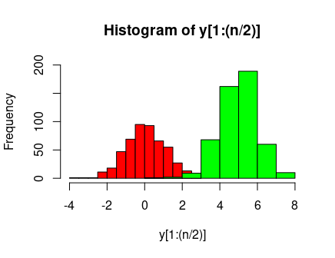
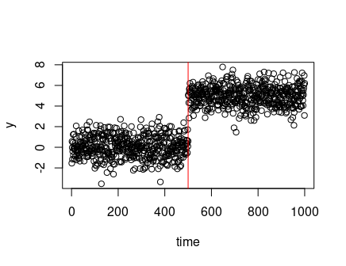
Visualization
Notes:
Go to R

Slide 45
Validity
Internal Validity: the extent to which the researcher is certain that a change in a dependent variable is actually due to the independent variable
External validity is taken care of if the test and control groups are representative
Notes:
Compare between lab experiment vs. field study

Slide 46
Internal Validity versus External Validity
Internal Validity: The degree to which an outcome can be attributed to an experimental variable and not to other factors. Lab experiments tend to have higher levels of internal validity
External Validity: The degree to which the results of an experiment can be generalized, or extended, to other situations. Field experiments tend to have higher levels of external validity
Online retailers are in an ideal position to conduct field experiments by testing different types or levels of marketing variables simultaneously and examining actual customer response.

Slide 47
Other Quasi-experimental Designs
For reference, check my book
Regression Discontinuity
Difference-in-differences
Synthetic Control
Event studies
Matching Methods
Interrupted Times series

Slide 48

15-min Group Discussion
Signup sheet: first come first serve basis
Items:
A general statement of the client’s problem
The decision(s) to be made + alternatives
Target for the decision: choose one
Managerial Objective(s)
Research Objectives: at least 2
Research Questions: at least 10
One word or pdf document only. Only 1 member needs to submit
Notes:
Hopefully, y’all get the gist of managerial objective, research objectives, and research questions by now.
Managerial objective: What the client hopes will result from the project to help them make decisions
Research objective: What information will help the client to achieve managerial objectives
Research questions: Questions that managers want to have answers

Slide 49
What’s coming?
Quiz 2 (Sunday)
Start discussing PA #3

Slide 50
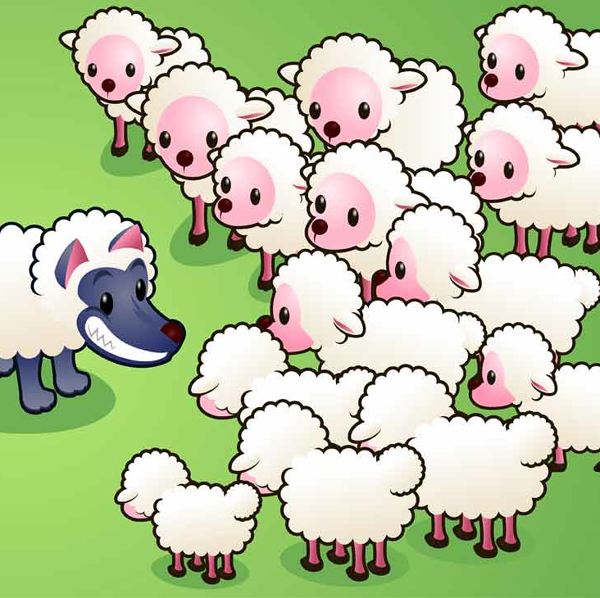
5-min Snippet
How agents (wolves and sheep) interact with environment (grass)
Try:
Different # of wolves
Different levels of energy gained from eating sheep
Different levels of energy gained from grass
Different grass growth rate
Notes:
https://www.netlogoweb.org/launch#https://www.netlogoweb.org/assets/modelslib/IABM%20Textbook/chapter%204/Wolf%20Sheep%20Simple%205.nlogo
How do you think agents will interact?
The population of sheep, wolves, and grass will fluctuate.
Try 10, 20, 30 initial wolves (the critical state happens very fast)
2.5 energy and 3.5 energy (take longer to drop dead)
a predator-prey model of population dynamics
The model creates a population of sheep that wander around the landscape. For each step the sheep take it costs them some energy and if their energy gets too low they die.
However, the sheep can eat grass in the environment to regain energy and the grass regrows over time.
If the energy of the sheep gets above a certain level then they can reproduce.
In this model, there are also wolves. Wolves have the same behaviors as sheep except for eating; rather than grass, they eat sheep.
Things to notice
How does the number of sheep affect the population levels? How does the number of wolves affect the population levels?
Is there a spatial relationship between where the sheep do well and where the wolves do well?
How does the presence of wolves affect the system?
Things to try
Change the NUMBER-OF-WOLVES, while leaving the NUMBER-OF-SHEEP constant, how does this affect the model results?
How does the ENERGY-GAIN-FROM-SHEEP affect the model results?
Try to play around with ENERGY-GAIN-FROM-GRASS and GRASS-REGROWTH-RATE. Does keeping the influx of energy constant but with different slider valeus (e.g. ENERGY-GAIN-FROM-GRASS as 1 and GRASS-REGROWTH-RATE as 2, and vice versa) give the same or different results? Why might that be?

